Slide 1



AI enhanced Image steganography with audio Encryption
Group #D7
Anjali C (BL.EN.U4AIE21011)
B Prahas (BL.EN.U4AIE21023)
Bharadwaj Aaditya (BL.EN.U4AIE21024)

Slide 2
Overview
Introduction
Problem Statement
Methodology
Results
Components and Features
Future Scope
Conclusion

Slide 3
Introduction
Integration of AI in Image-to-Audio Encryption.
Paradigm Shift in Multimedia Security.
Research Focus on AI-Enhanced Data Hiding.

Slide 4


Problem Statement
This project aims to address challenges in secure multimedia data transmission by integrating advanced steganography and fusion techniques, ensuring confidentiality, integrity, and covert communication for enhanced privacy preservation.

Slide 5
Components and Features
Efficient use of network resources.
Privacy Preservation
Image steganography
Preserves user privacy in multimedia transmission
One image hidden in Another image
Hide Net
Image to audio Encryption
Concealing information within images while preserving their visual integrity and avoiding suspicion.
Reveal net
Extract concealed information from images that have undergone steganographic processes
Converts resultant Image with hidden image to an audio

Slide 6



Literature Review
Advancements in Deep Learning for Data Hiding:
Deep learning techniques, particularly in watermarking and steganography, are revolutionizing digital security.
Steganography Implementation:
Image data into audio files using LSB-based audio steganography and deep learning models are utilized as well.
Innovative Techniques in Audio and Image Encryption:
Diverse methods, including asymmetric audio and image encryption, reversible data hiding, and steganography

Slide 7
Our Approach’s Imports
Torch: Provides tensor operations and dynamic computational graph construction for machine learning models
Torch.nn: Neural network building blocks, including layers and loss functions, facilitating the creation and training of deep learning models.
Torch.optim: Implements optimization algorithms for adjusting model parameters
Os: Interacts with the operating system, allowing tasks such as file and directory manipulation.

Slide 8
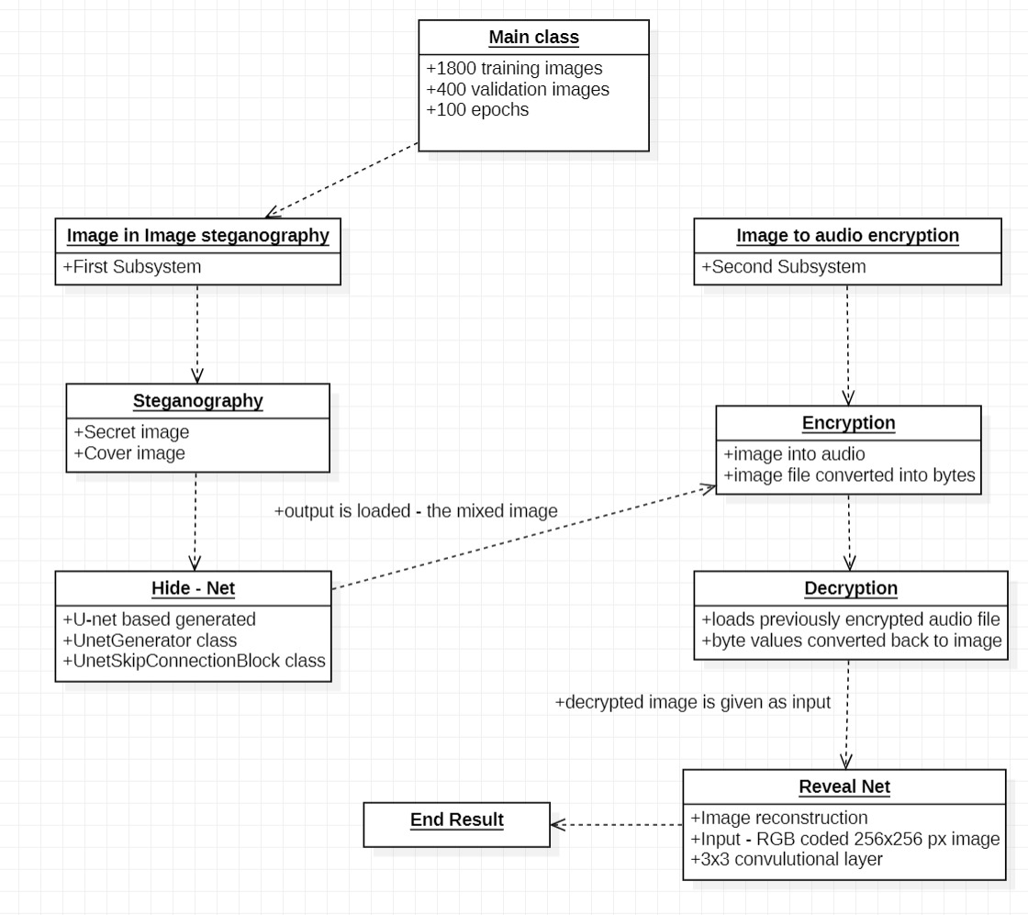

Methodology

Slide 9
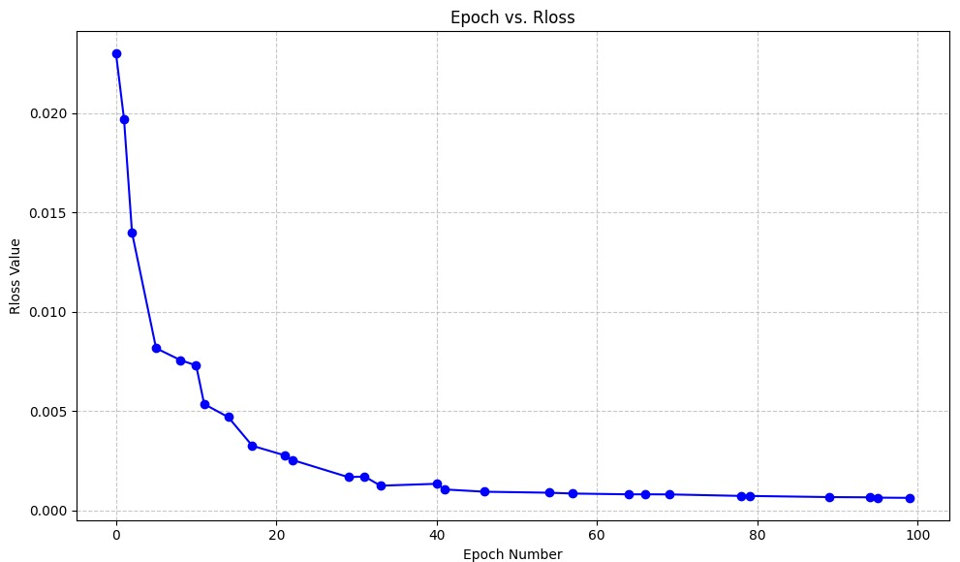
Results

Slide 10
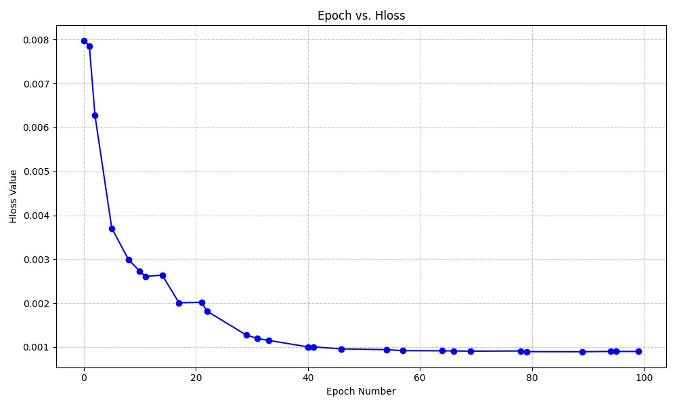
Results

Slide 11
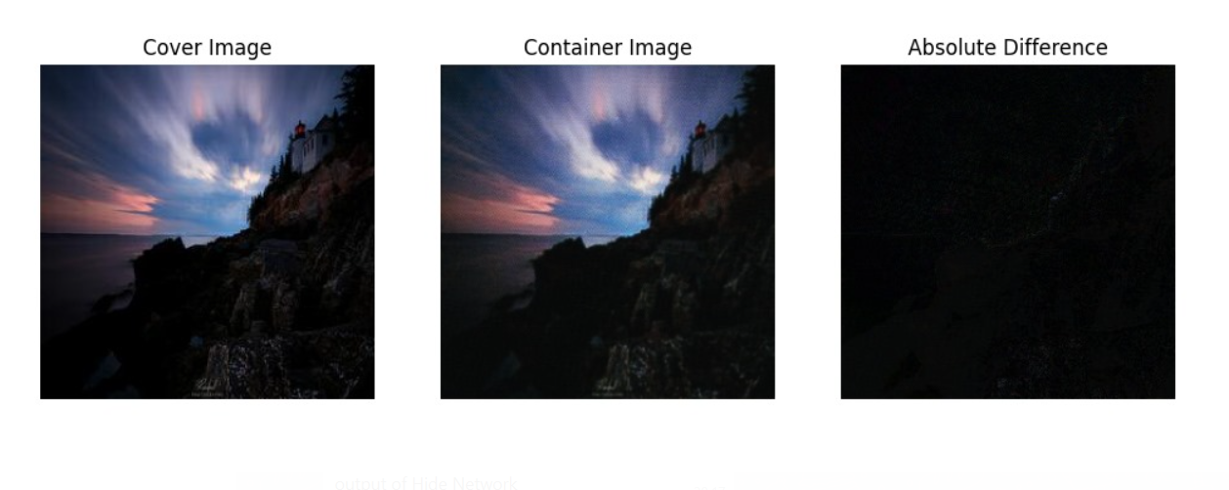
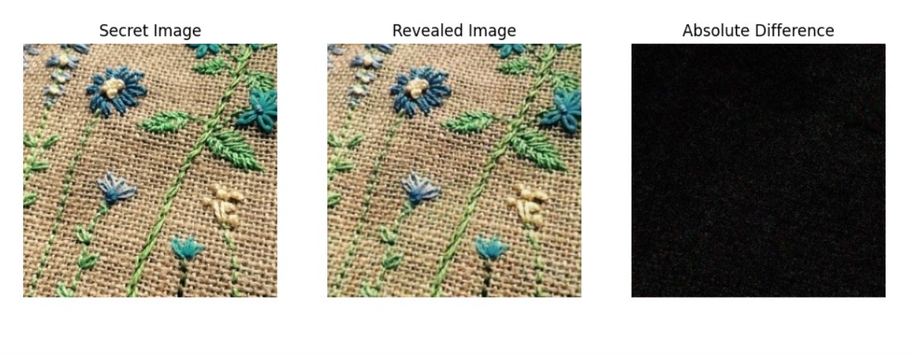
Results
Absolute Difference between Cover image and output of Hide Network. Loss: 0.0008769232663325965
Absolute difference between Secret image and Image Revealed by Reveal Network. Loss: 0.0026543575804680586

Slide 12
Conclusion and Future Scope
Innovative Fusion: This project integrates image-to-audio encryption with advanced AI, fortifying secure multimedia communication.
Neural Network Strength: The Unet (Hide-Net) and Reveal Net showcase potent neural structures for multimedia data concealment and retrieval.
Future enhancements include optimizing neural networks, exploring new structures, and implementing smart AI techniques.
Expanding to diverse media, incorporating real-time capabilities, and collaborating with experts for heightened security measures.

Slide 13
Thank You

